Slide 1


Machine Learning Level 2: Algorithm Optimization and Deployment
Joseph Alexius Tapang
Business Intelligence and Systems Infrastructure
041146039

Slide 2
1. Introduction
Overview
This project simulates the application of data analytics implementation lifecycle. All machine learning algorithms done through previous laboratory exercises in notebooks were optimized, then implemented online based from coding and methodology best practices.
Problem statement & objectives
In a real world setting, data analytics are done through projects. Analysis require properly documented findings and properly implemented codes. Given the need, how do we properly code and deploy the application?
Importance
Knowledge in code optimization and deployment improves work quality and productivity.

Slide 3
2. Methodology
Data collection: Data used in this projects were provided with the lab exercises completed during level 1.
Tools
Programming Environment: VS Code
Programming Language: Python
Libraries: pandas | pickle | streamlit | logging | scikit-learn | matplotlib | seaborn
Techniques: Algorithms used were Linear Regression, Random Forest, K-Means, and Neural Networks
Framework: CRISP-DM (Business Understanding, Data Understanding, Data Preparation, Modeling, Evaluation, Deployment)

Slide 4
3. Data
Each algorithm used has its own dataset as listed below:
Linear Regression
Topic: Housing Prices Prediction
Classification
Topic: Survivability Prediction
Clustering
Topic: Customer Mall Segmentation
Neural Networks
UCLA Admission

Slide 5
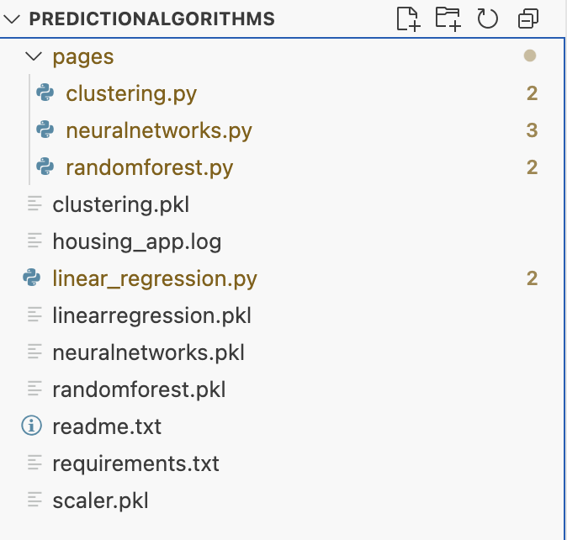
4. Results
Modularization: Code has been modularized into separate files.
VS Code Structure: A project folder named “predictionalgorithms” has been created, containing the structure format:
predictionalgorithms (project root folder)
pages (contains other algorithms)
linear_regression.py (main application file)
pickle files (saved algorithms)
readme.txt (information about the project)
requirements.txt (required libraries to run the application)

Slide 6
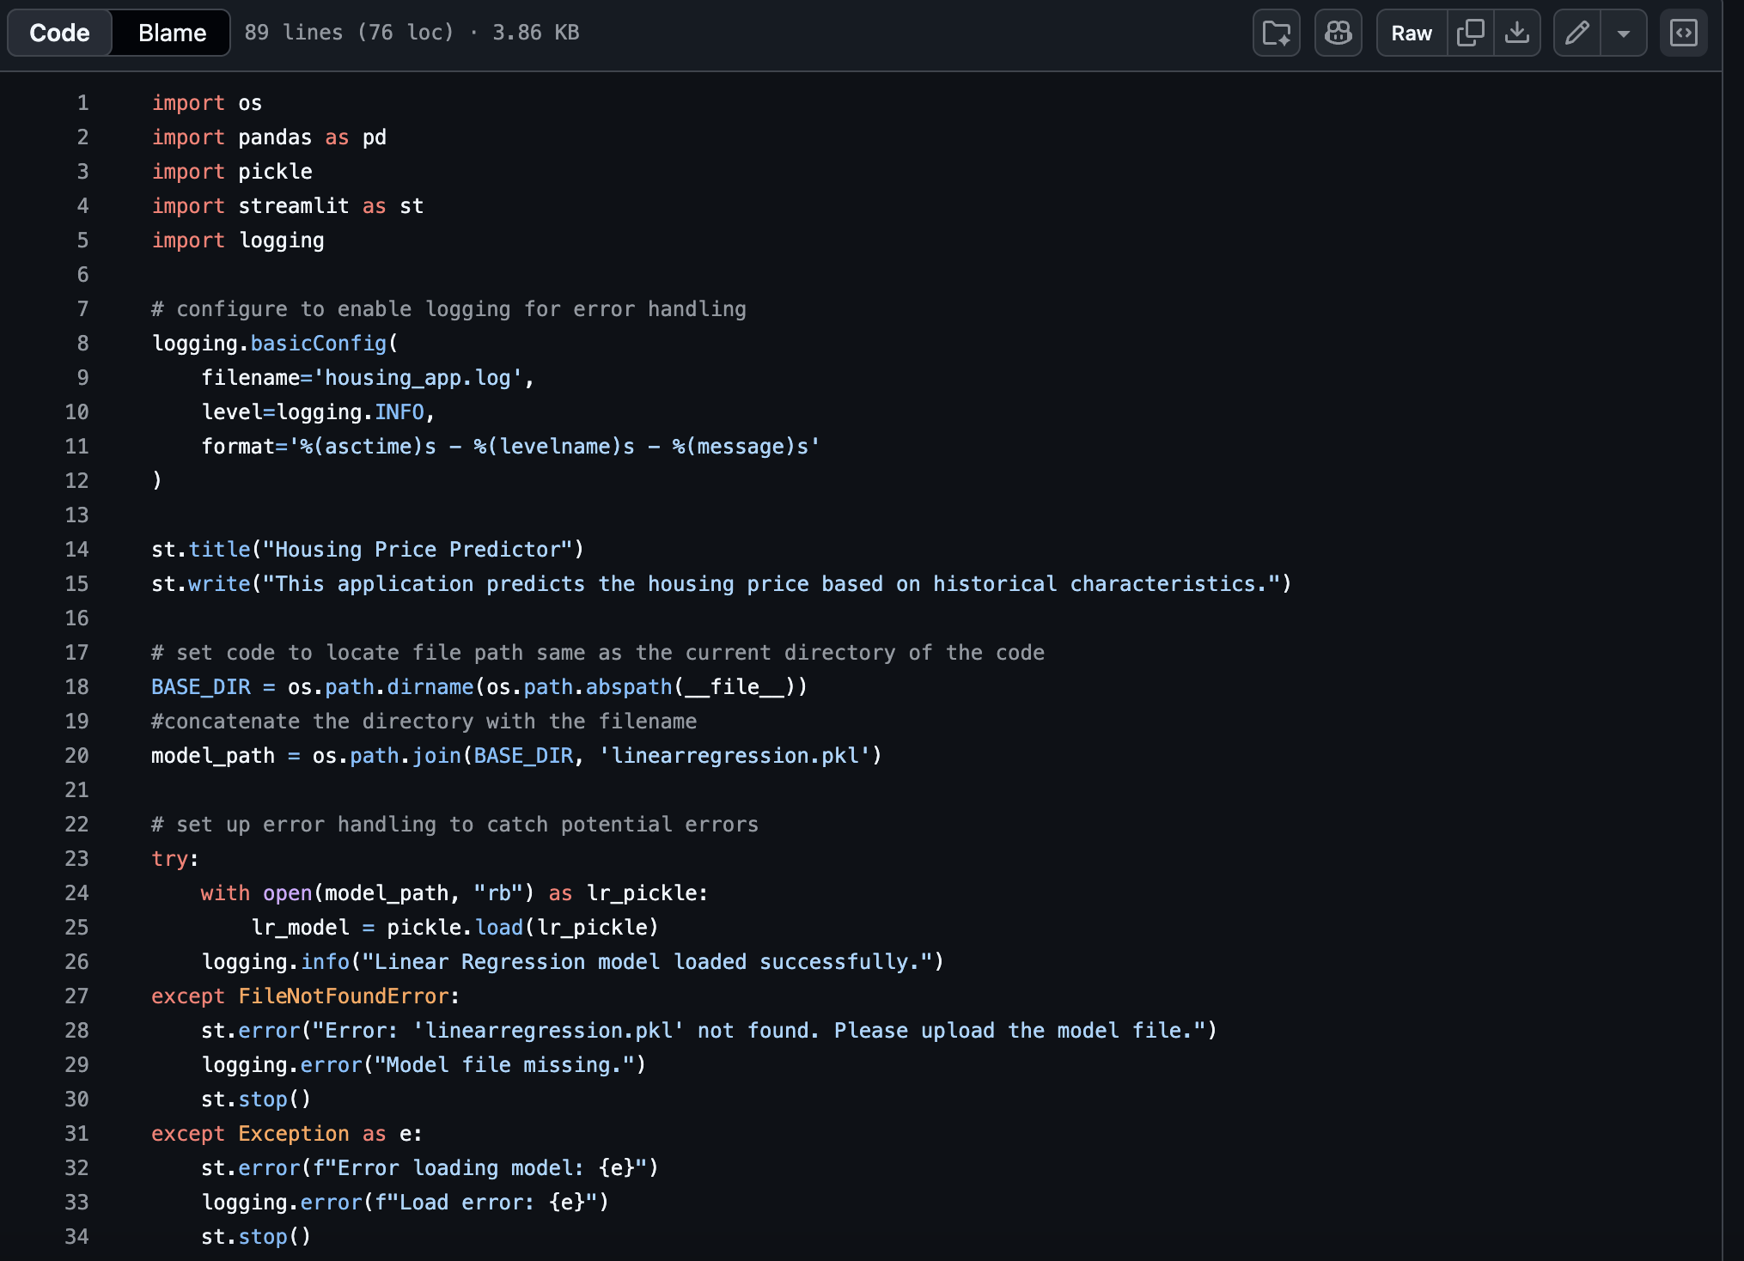
4. Results
Code Quality, Logging and Error Handling: All codes were aligned to a similar structure. Executable codes were nested under a try and catch function, incorporated logging to record errors.

Slide 7
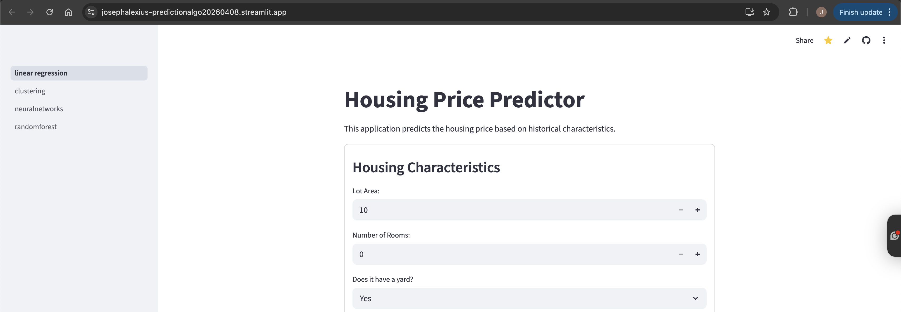
4. Results
GitHub and Streamlit Deployment
Code has been efficiently hosted in GitHub and published for public access via streamlit.io which successfully applied deployment practices in the workplace.

Slide 8
5. Limitation
Streamlit technical constraints – Since streamlit is a rendered application, this can be inefficient in large scale deployments since it is less customizable than other platforms.
Pickle versioning – Models saved as pickle files may encounter version issues if deployed on another server.
Static training – Since the models are trained in a certain kind of dataset then saved as is, it is not possible to apply the model directly to additional attributes which can limit the potential for improving predictions and solving additional business problems.

Slide 9
5. Conclusion
This project has detailed the transformation of machine learning theory into a functional, deployed application.
By adopting modular coding standards and proper deployment procedures, we have established a foundation for professional data science development and deployment.

